Slide 1

CGPA CALCULATOR
Programming Techniques II
Final Project
Presented by:
Vivianna Amelissa
Toon Shu Hui
Yee Zi Wei

Slide 2
Introduction
This is an interactive program created by Vivianna, Shu Hui and Zi Wei *specially* for School of Computing. This program allows lecturers to input student’s name, matric number, subject codes and marks. Firstly, the CGPA Calculator will accept input of the string subject code, then it will generate the subject name after comparing the string in “code.txt” file. To obtain the credit hours, it extract the last value of string subject code and change it from string to integer. Next, lecturer will need to input the marks for each subject, the calculator will then generate the grade and grade point. With the credit hours and the grade points obtain, the program will the calculate the CGPA of the student.

Slide 3
Introduction
In this program, we created three classes. Which is class Calculate, class Subject and class Student. We also use file stream and aggregation in completing our program. At the end of the program, it will generate an output file “result.txt”. The output file will record the name, matric number and all the data calculated.
Let’s take a look on what is in our CGPA Calculator <3

Slide 4
CLASS UML DIAGRAM
Calculate
- cgpa: float - gpa: float - gradePt: float - TPV: float - tolTPV: float - grade: string - credit: int - tolcredit: int
+ Calculate(int, int) + calGrad( float): string + calcGradePt( float): float + extractCredit(string): int + calctolCre(int): void + calctoTPV(float): void + calcTPV(float, int): float + gettolcredit(): int + gettolTPV(): float
Subject
- sub_info: string - grade: string - mark: float - _tpv: float
+ Subject() + Subject(string, string, float, float) + setInfo(string, string, float, float): void + getSubMark(): float + getSubInfo(): string + getGrade(): string + getTPV(): float + getSubName(string): string
Student
- _subjectlist: Subject* - _studentlist: Student* - student_count: unsigned int - subject_count: unsigned int - name: string - matric: string
+ Student() + Student(string, string) + addStudent(Student*): bool + setInfo(string, string): void + getName(): string + getMatric(): string + returnNM(int): string + returnN(int): string + returnM(int): string + addSubject(Subject*): bool

Slide 5
Extract Credit from Subject Code
String -> Int ?
Get String of Subject Name Based on Subject Code Input
Read input file?

Slide 6
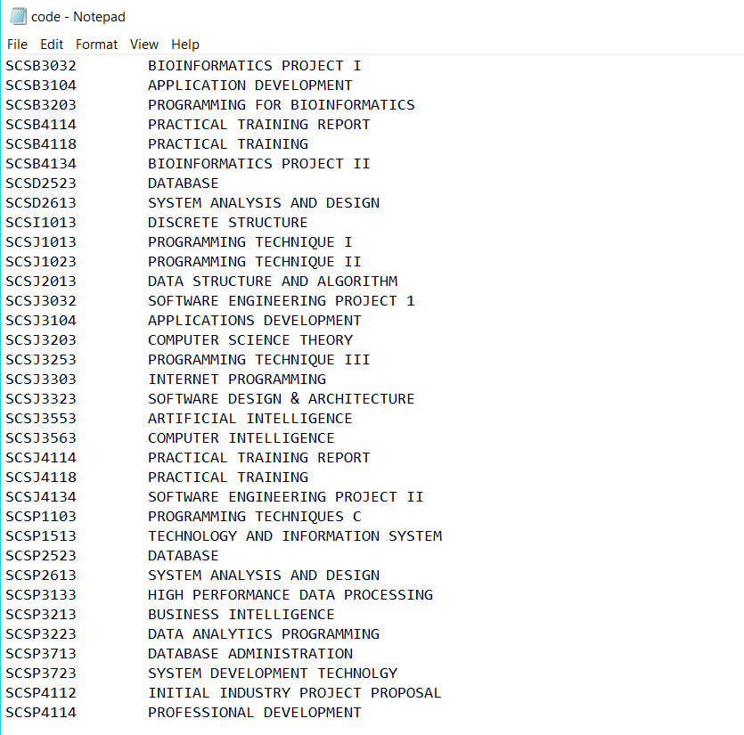
Input File - code.txt
A list of subject code and subject name offer in School of Computing …………………..

Slide 7
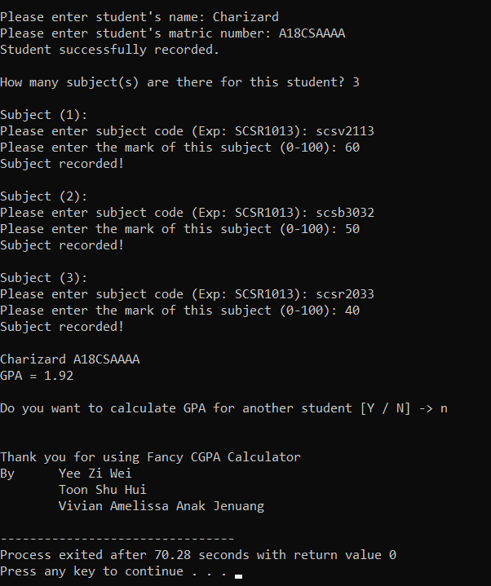
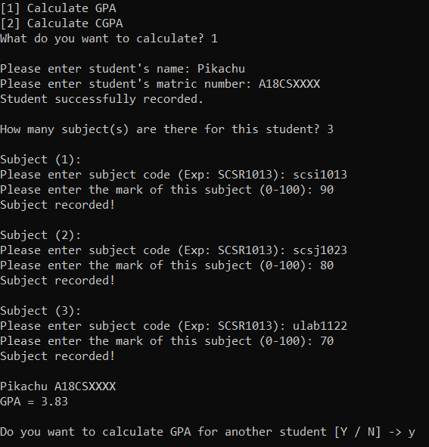
Choice 1 :
Calculate CPA
Student 1
Student 2

Slide 8
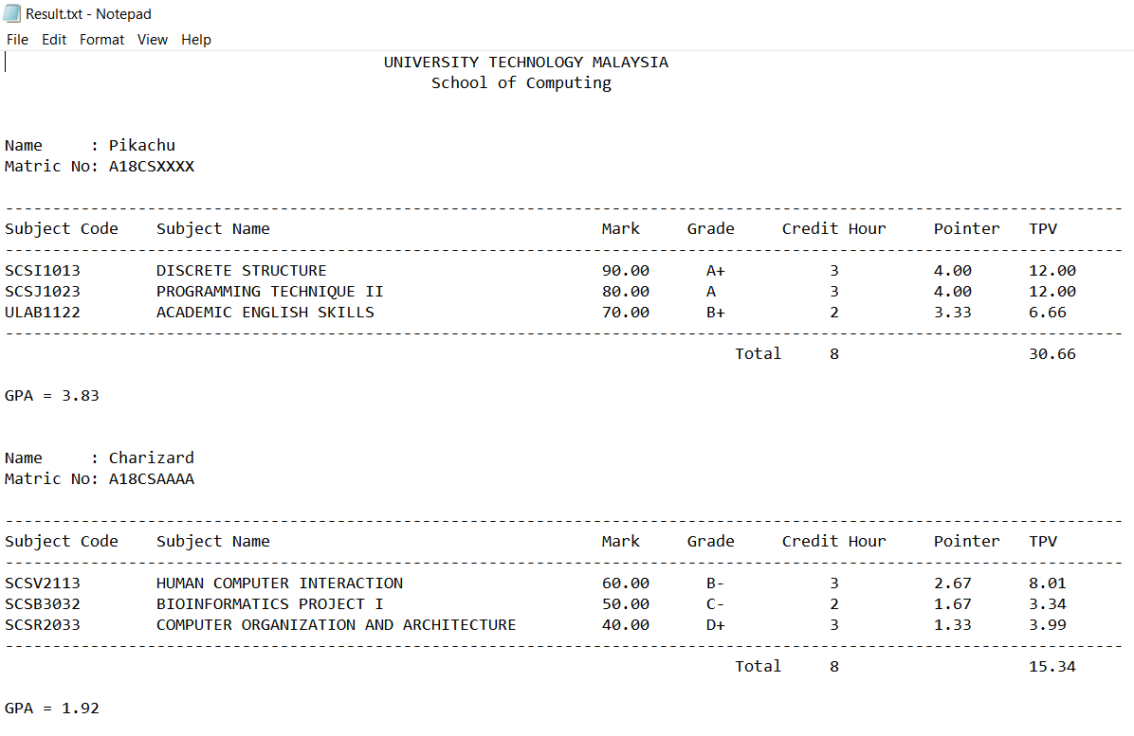
Output File -result.txt
The GPA calculated
For two students.

Slide 9
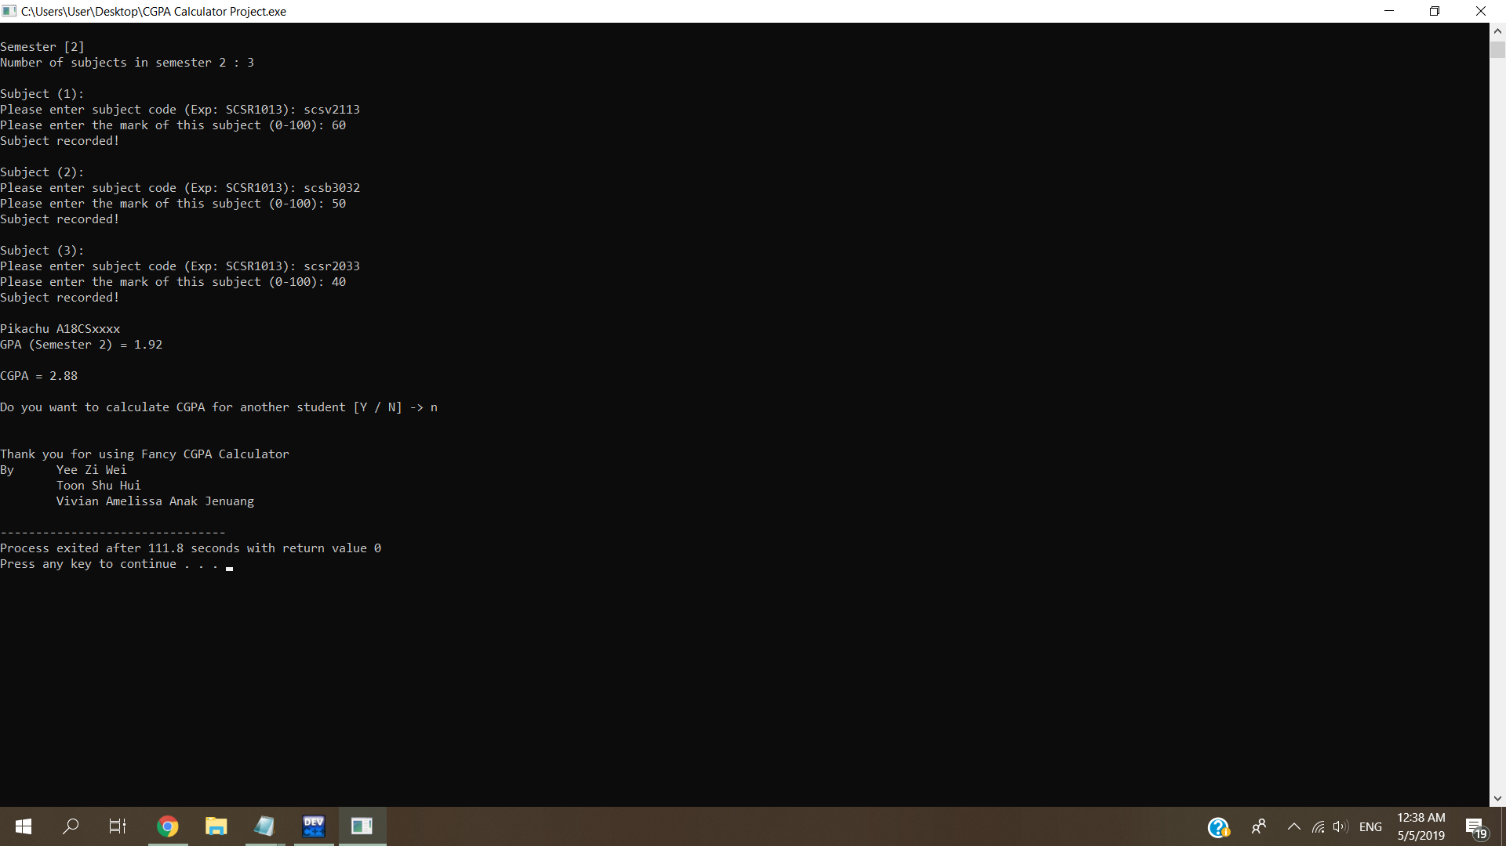

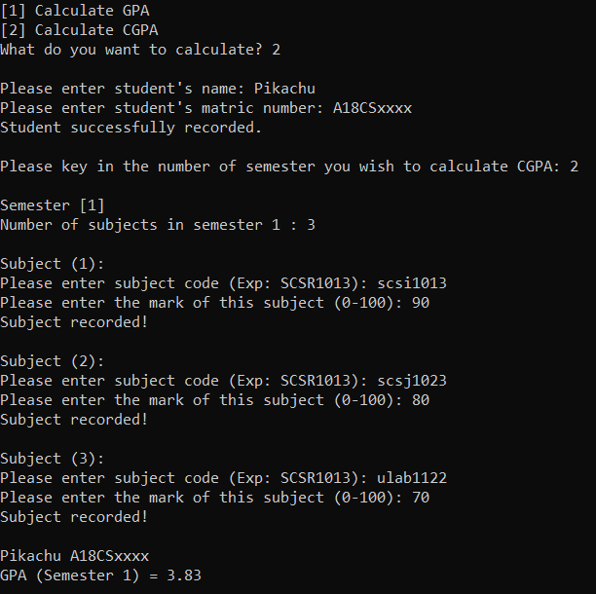
Choice 2 :
Calculate CGPA
Semester 1
Semester 2

Slide 10
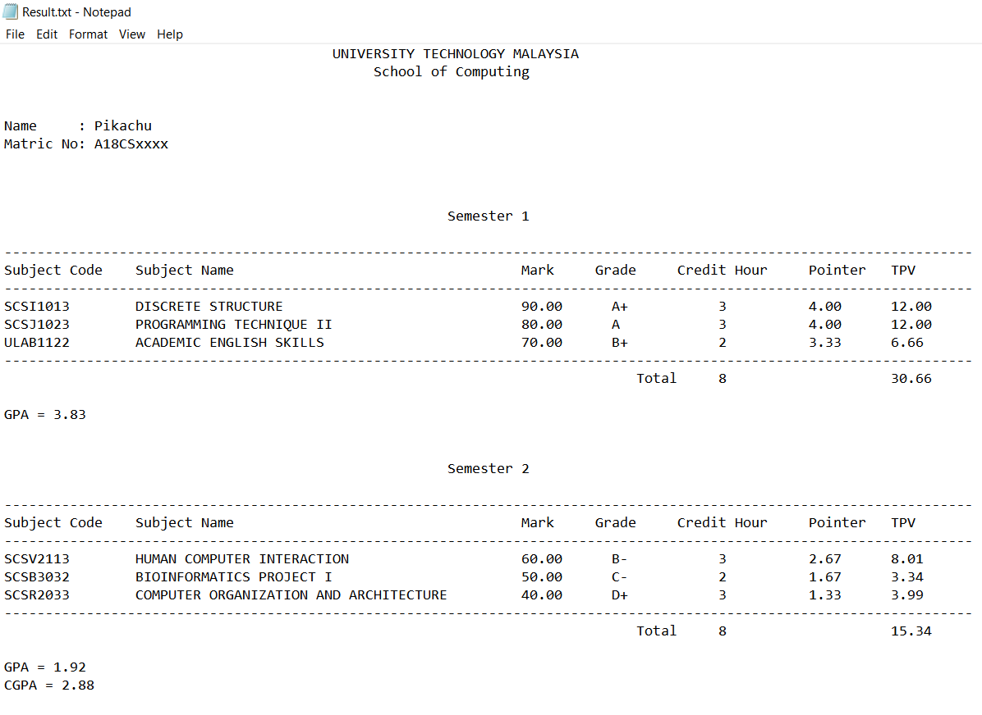
Output File -result.txt
The CGPA calculated
For two semester.

Slide 11
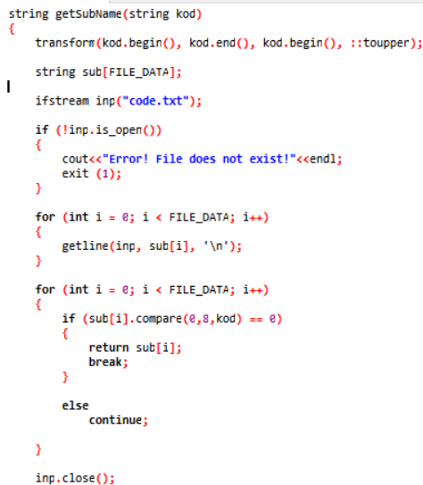
Special Function :D
This line of code is used to change the input string to uppercase. An extra library is needed in order to use this code.
# include <bits/stdc++.h>
We compare the string to the first 8 character of each line in the input file, when the condition is true, the line of string that match will be store in sub[i] and the loop will break. The output file will print out the subject code + subject name.

